Slide 1
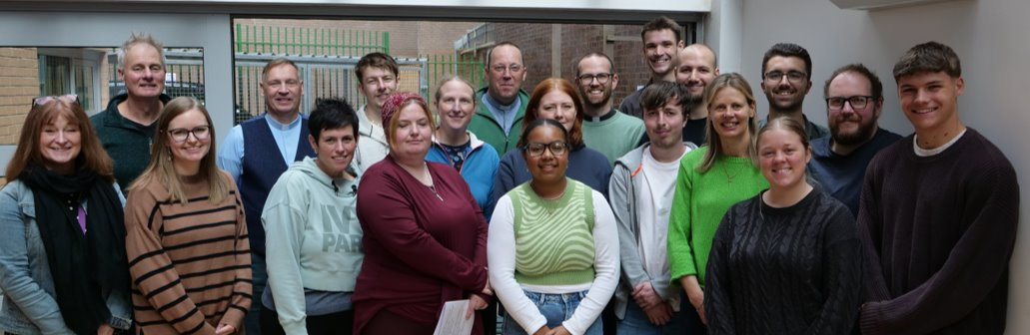

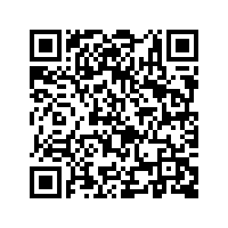



The Diocese of Leeds Internship Scheme
What would happen if you gave a year to God?

Slide 2
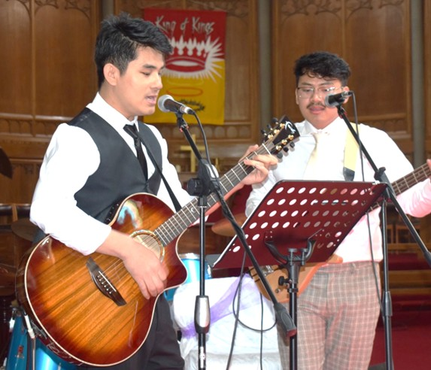
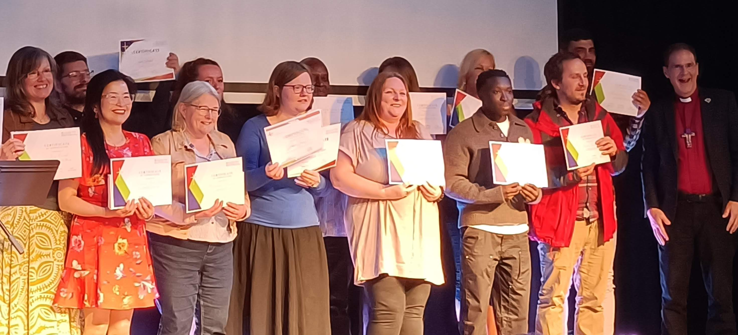
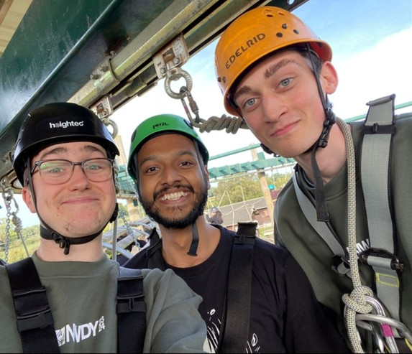



The Diocese of Leeds Internship Scheme
What would happen if you gave a year to God?

Slide 3
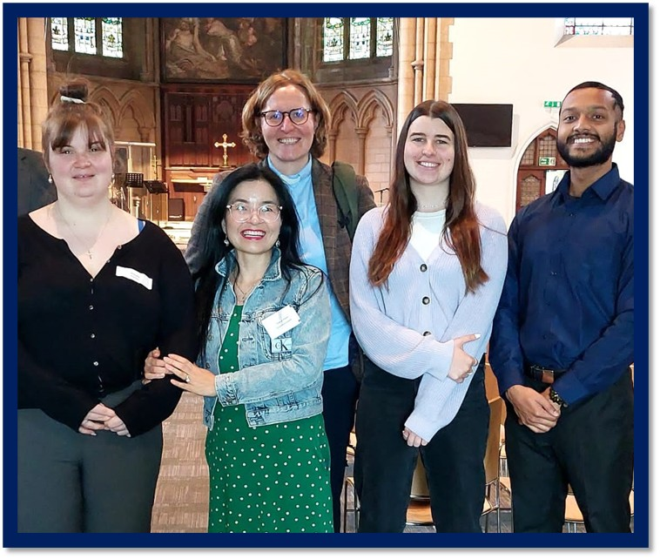

The Diocese of Leeds Internship Scheme
"The internship is a great chance to grow with God and explore your calling."
"It gave me a strong foundation of faith and friendship, and taught me a brilliant understanding of the bible, and a life with Jesus! I'd recommend it to anyone looking to develop their faith or start their discipleship journey!"

