Slide 1
Notes:
Hello and welcome to our talk on the Anglican Churches in Tanzania or ACT Mara – a North Western region of Tanzania.
We are here to tell you about Keeping Girls safe from FGM – or Female Genital Mutilation in this rural area of Northern Tanzania.
The practice of FGM is still carried out in parts of Tanzania, despite it being illegal since 2009. In a few tribal cultures, this act is seen as ‘purification’ before marriage, and may lead to a larger wedding dowry.

Slide 2
MARA REGION
Notes:
Here is a map of Tanzania – Mara is the area at the top of Tanzania – bordering the South East coast of Lake Victoria.

Slide 3
Serengeti Sunset

Slide 4
Tanzanian Safari

Slide 5
Majestic Giraffes

Slide 6
Camouflaged Leopards

Slide 7
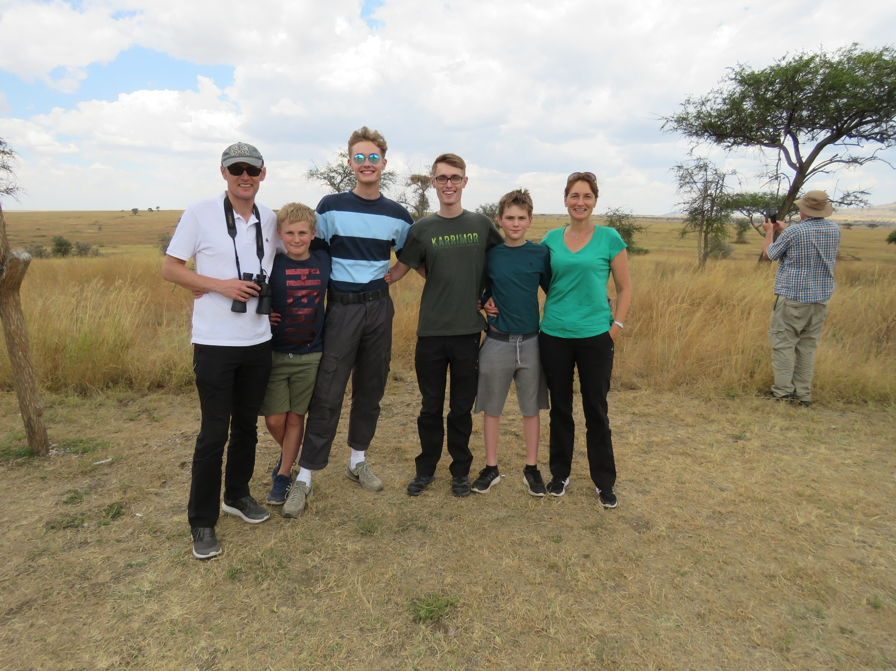

Slide 8
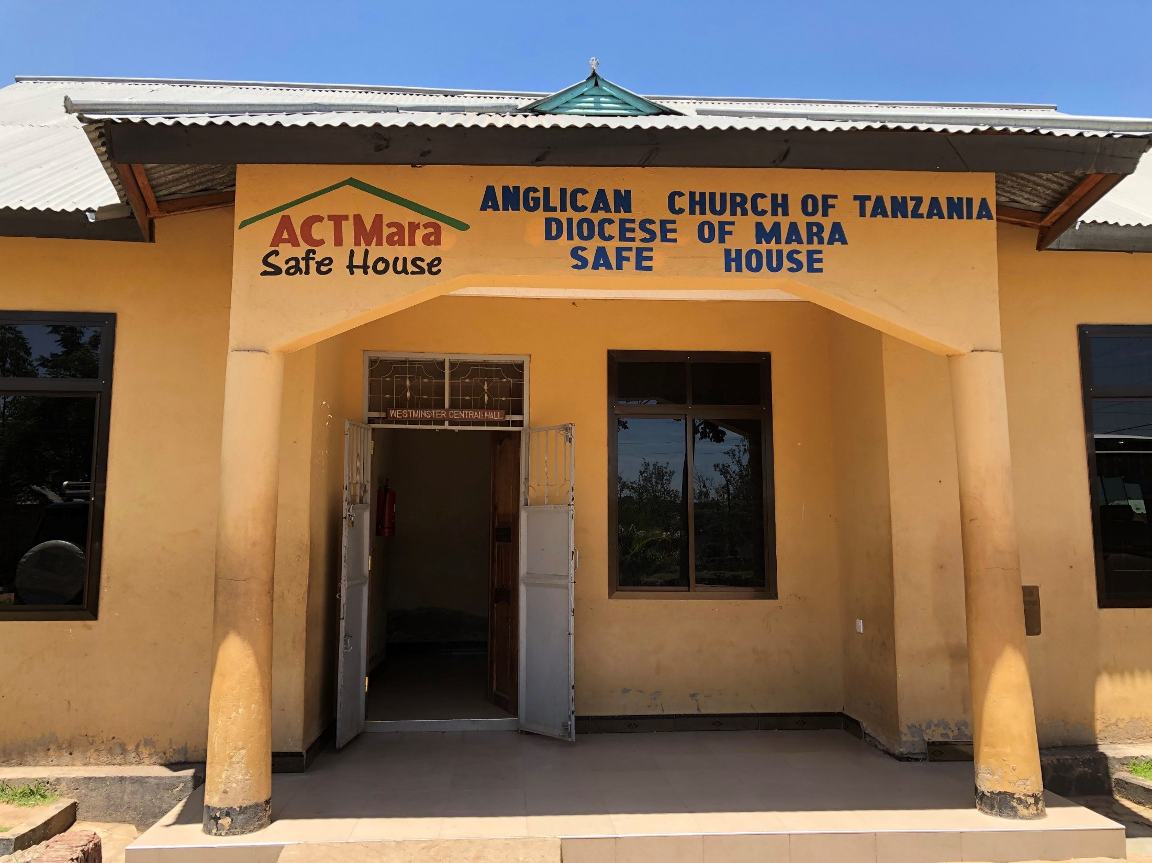
Notes:
Introduction:
In 2009 the Anglican Vicar of Mugumu took a young girl into his care in order to protect her from FGM.
From this one act, the idea of a Safe House was born.
With funding from the Anglican Churches in Tanzania, and with the help of Tanzanian Development Trust, a building was constructed in 2014 which can house 80 girls.
It often has more in the cutting season – which happens in Nov and Dec in alternate years.

Slide 9
Notes:
The Safe House provides
Food, shelter and a home
Access to education
Family reconciliation
Raised awareness of FGM
Skills training – in order to train the girls for work for the future
Currently all funding for the Safe House comes from the Anglican Church but there are plans for income generating projects, to make it more self-sufficient.

Slide 10
FGM or Female Genital Mutilation
Seen in many African countries, also Asia and the Middle East
Over 230 million girls worldwide have undergone FGM
Involves partial or total removal of external genitalia
In Tanzanian culture (certain tribes) practice FGM – the ‘cutting season’
A way of a family getting a bigger marriage dowry for their daughters

Slide 11
FGM or Female Genital Mutilation
Impact of FGM – makes sex and childbirth at least painful and at worst life threatening
Illegal in Tanzania
Social pressure to ‘be cut’
It is about controlling girls/ women at its heart – and is often presented as a spiritual practice or a duty to the family
That’s why education is so important

Slide 12
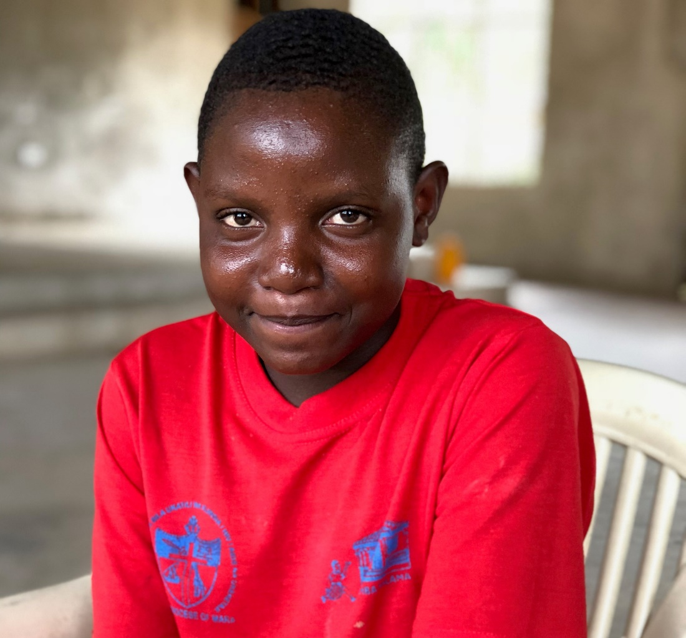
Pili and Jackline
Notes:
Pili was aged 13 when this was taken. She was pledged to be married to an older man who already had many wives. A family member rescued her and took her to the police station. They brought her to the safe house in April 2018.
Update – Pili is now in standard two at a local primary school. She is 14 years old. Her father and mother visited her and her father was impressed to learn that Pili is now going to school. The liaison staff talked to him about sending Pili's younger sister to school – which he would like to do – he will struggle to afford the uniform though..
The Safe House does reconciliation work too.
Jackline has lived in the Safe House since the age of 13. When she was told she had to be cut before marriage, she asked women in her village what was involved, and learned of the many physical and emotional problems caused by FGM. She learned that some girls even died from the infections caused by the practice. At the Safe House she has been able to continue with her education and now hopes to help girls in a similar situation.
Update – Jackline is now 19. She is continuing with her college studies and is taking a year course in Professional Tour Guiding at Serengeti Tourism College in Mugumu.

Slide 13
Notes:
We are currently raising funds to build a fence around the Safe House – current cost estimate is £17,000.
The fence is needed for protection purposes as the Safe house is exposed with no boundary.

Slide 14
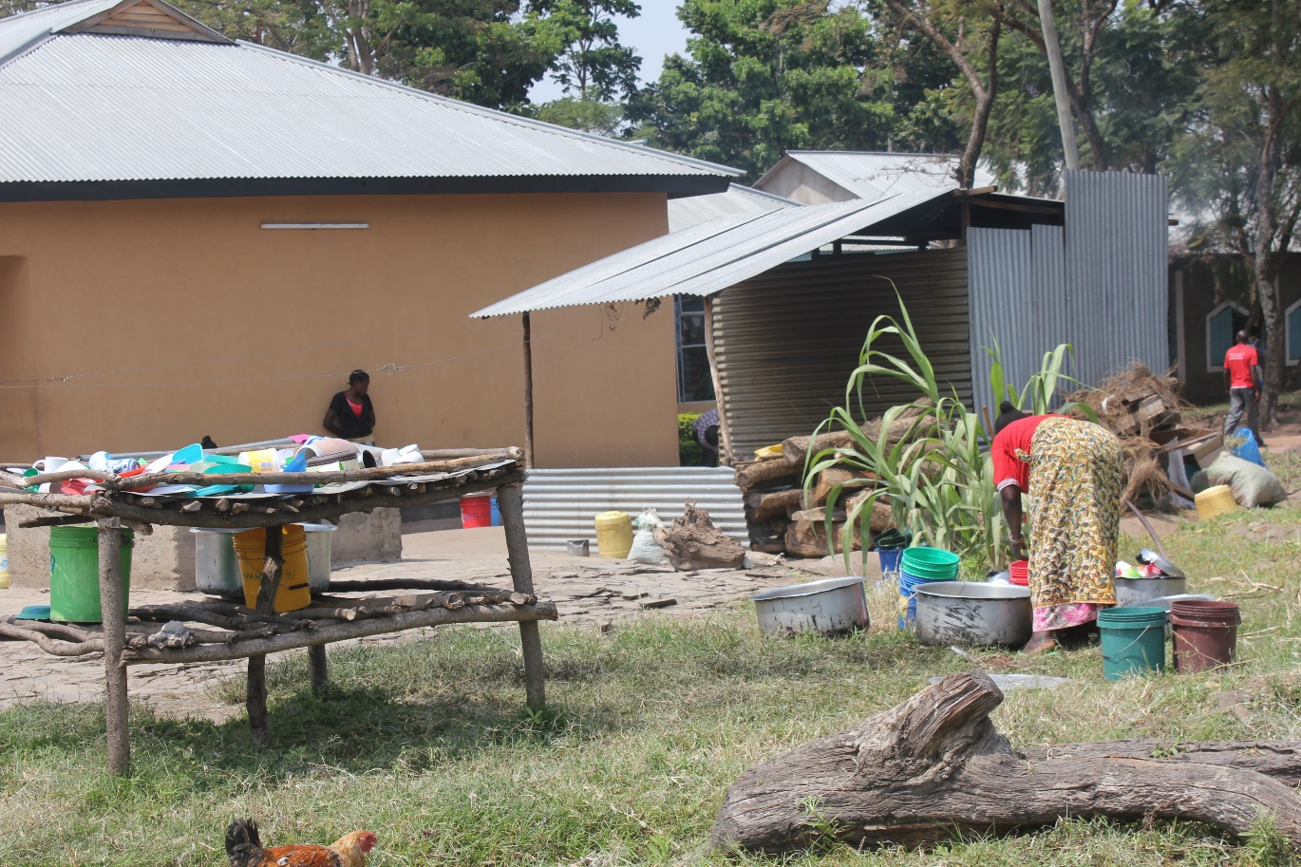
Life at the Safe House – In the grounds
Notes:
Around the grounds – old kitchen still used and water tank recently installed

Slide 15
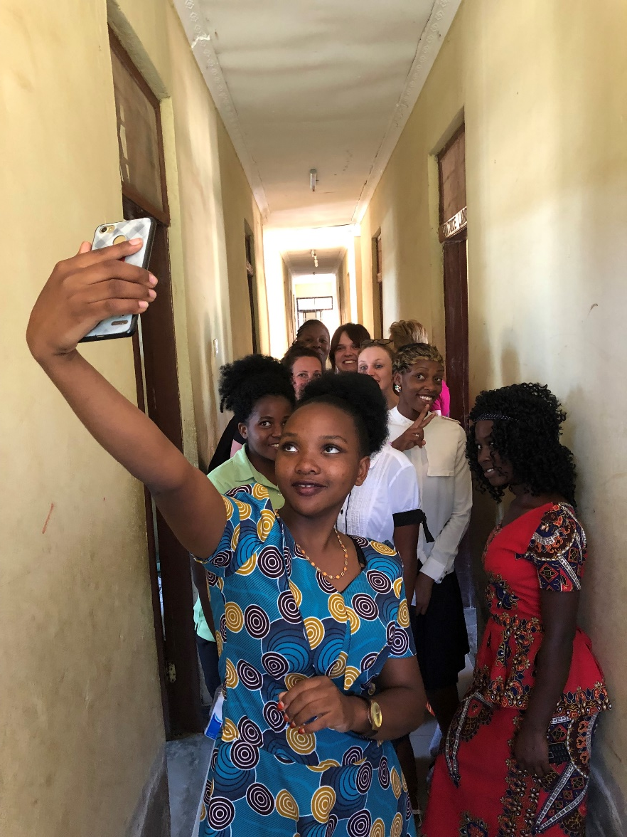
The Dorms – girls will be girls!
Notes:
Live in rooms of 4 but during the cutting season they sometimes have to double up to make room for the girls fleeing their homes. And like all young girls they like their selfies with visitors!

Slide 16
Signs in the villages – No to FGM
Notes:
Government = practise is illegal

Slide 17
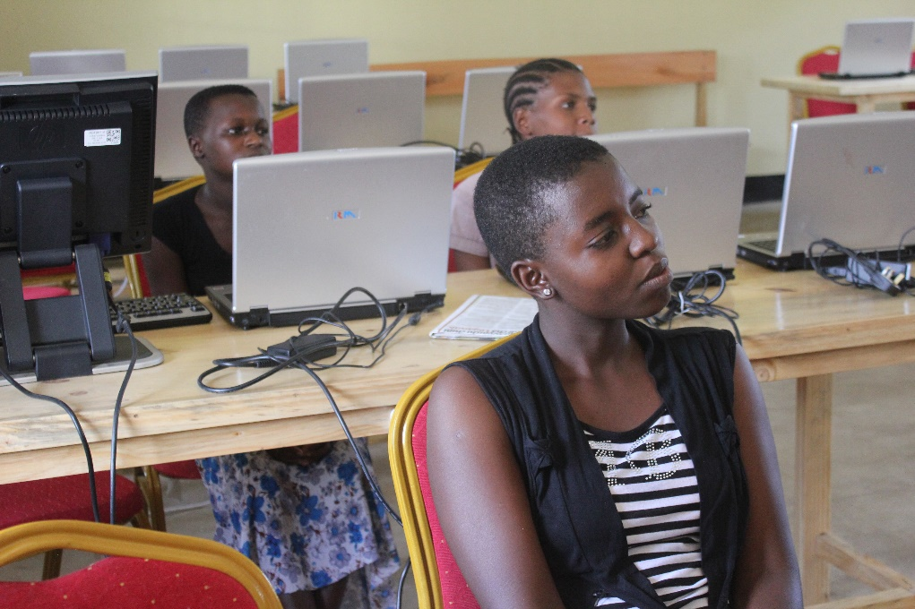
Funding is needed for vocational teaching…
Notes:
Vocational Training – the Safe House undertakes vocational training with the girls – teaching them sewing and tailoring skills – so they can support themselves.

Slide 18
And transport – to go to the villages to teach against FGM practices
Notes:
Transport needed to do teaching against FGM in the villages

Slide 19
And school transport – funds are needed for fuel and upkeep and the drivers
Notes:
Girls of school age are taken to local schools to continue their education.

Slide 20
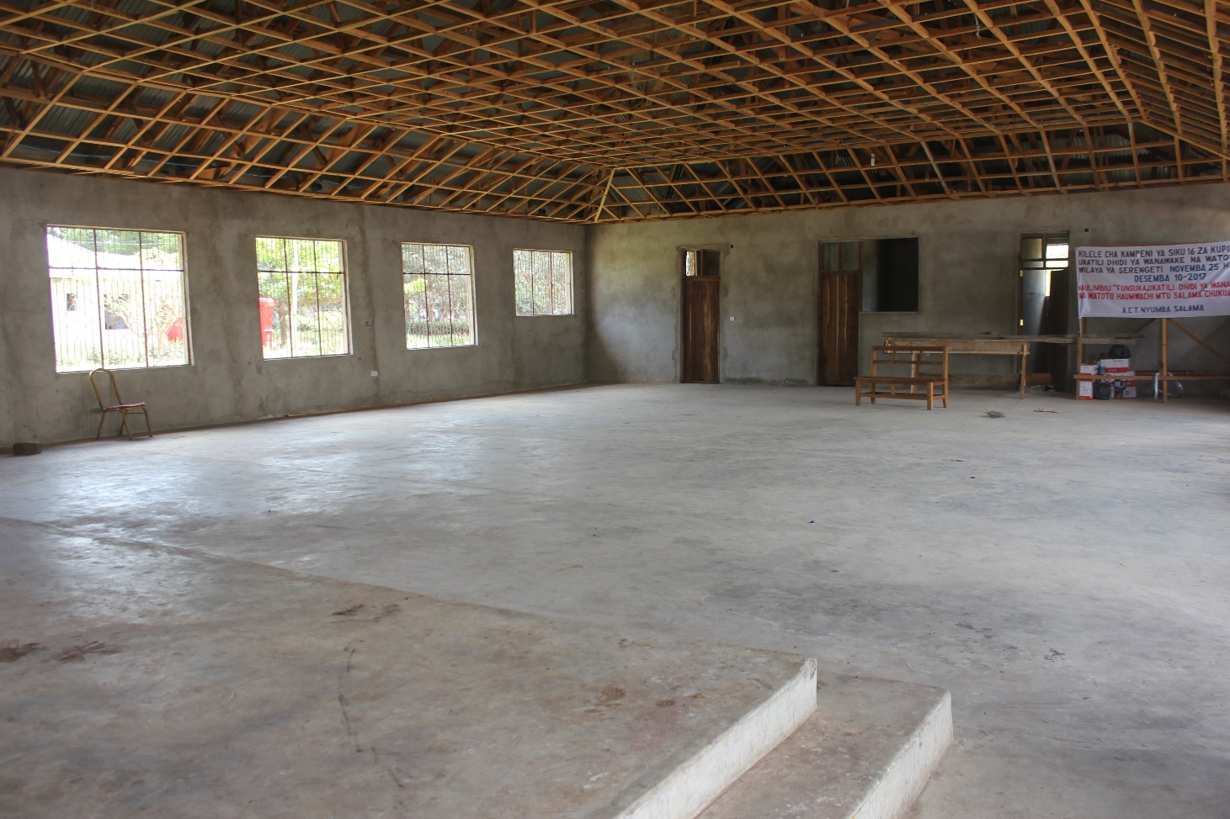
And to get the hall and kitchen fully operational
Notes:
Hall and kitchen with help of local Four Seasons Lodge – perhaps to be developed so that the Safe House can raise its own money

Slide 21
Notes:
Melina and some girls

Slide 22
Safe House Stories Mung ‘Osi’s Story

Slide 23
Benia’s Story

Slide 24
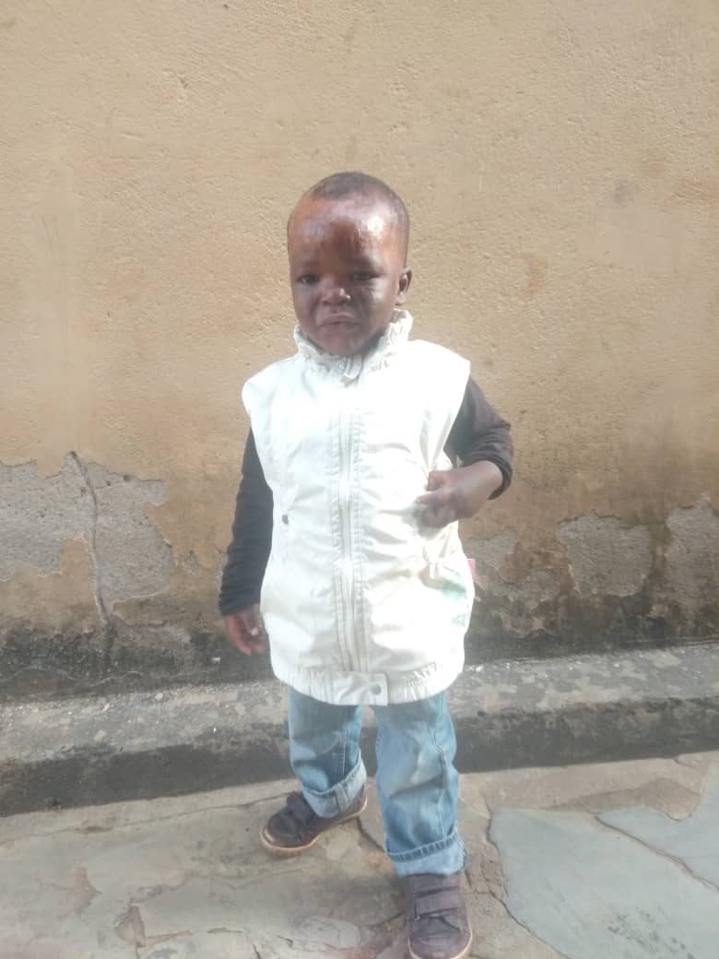
Benia is now 5
A happy boy who will soon be going to school

Slide 25
Any Questions?

